Slide 1
Perfect School

Slide 2
Perfect School?
Actually education system is not perfect, but we have some ideas how to improve it and make life easier for students and teachers.

Slide 3
Perfect School
What school building should look like TO BE called perfect?

Slide 4
Perfect school should be computerized.
Tablets and laptops instead of notebooks? Why not, students wouldn’t need to carry notebooks and heavy handbooks.

Slide 5
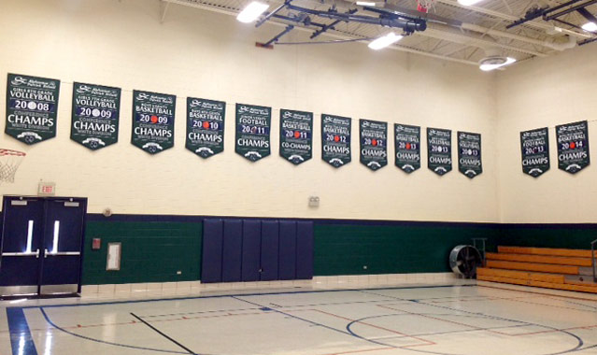
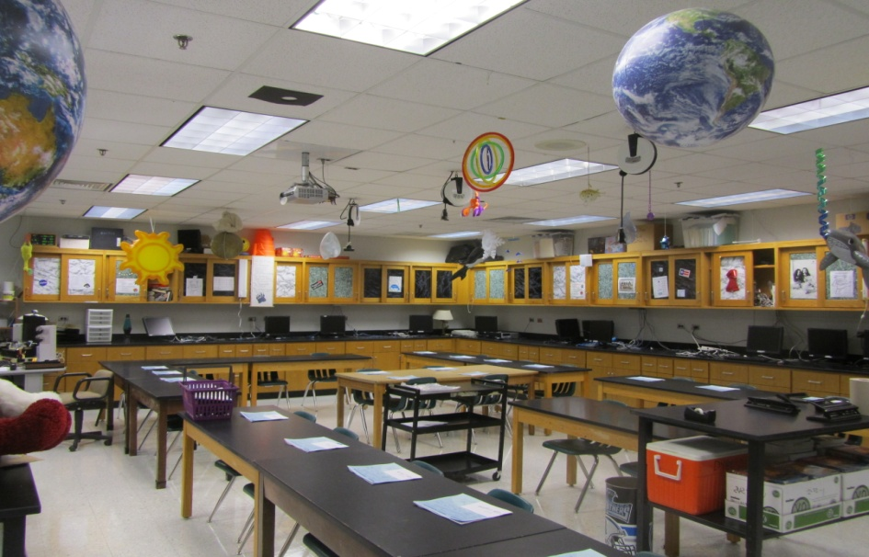
School should provide modern classrooms, gyms and science labs.
Perfect school should have modern, classroms, where students can develop their interests!

Slide 6
School canteen should serve mainly healthy food, but exceptions would be welcome (chips for example).
Healthy food is needed to keep students fit. But sometimes pizza would be perfect…

Slide 7
Perfect School
What TEACHERS should be like to be called perfect?

Slide 8
Replace teachers in a bad mood for the teachers in a good mood
Everyone will be happy, angry teacher will go home, and happy teacher will be… happy.

Slide 9
Individual approach to each student
Students have their own interest and passions. School should be able to develop these and adjust lessons to every student.

Slide 10
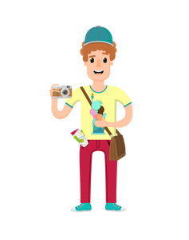
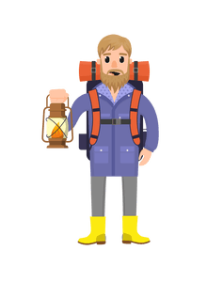
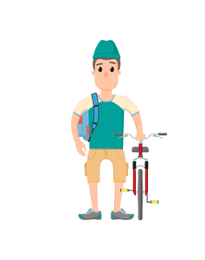
School should enable students to travel all around the world!
Perfect school can’t limit its students. Exploring the world is something really important. By travelling students can learn about foreign cultures in the best way possible.

Slide 11
Is my school perfect???
Probably not
But for us is SPECIAL

