Slide 1
Gender inequality in Poland
Factfile

Slide 2
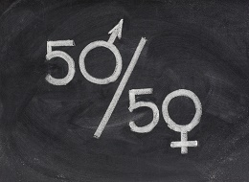
Gender Equality-facts
European Institute for Gender Equality is a full-fledged European Union agency for gender equality. The Gender Equality Index (is an index for measurement of gender disparity) was published in 2013 and 2015. In October 2017, the third edition was released. European Union index is a litttle over 50% what means EU is half-way to gender equality.
Poland got almost 44%.

Slide 3
Gender Equality-facts
The world Economic Forum (an independent international organization committed to improving the state of the world by engaging business, political, academic and other leaders of society to shape global, regional and industry agendas) in 2014 published report – summary of gender equality issues around the world. Poland is 57 (out of 142 countries).

Slide 4
Gender Equality-facts
According to the report Polish women:
-earn 53% of what Polish men earn;
- take only 32% seats in the parliament;
- take 50% less higher positions in job than men

Slide 5
Gender Equality - facts
The policy on gender equality in Poland was thoroughly studied by the European Parliament’s Committee on Women’s Rights and Gender Equality and commissioned, overseen and published by the Policy Department for Citizens’ Rights and Constitutional Affairs. The study presents a review of the most important legislation, institutional arrangements and policy programs with regard to gender equality in Poland.

Slide 6
Gender Equality - facts
Equal participation in politics and in economic decision making
KEY FINDINGS
• Since 2011, an electoral gender quota system is in force. The new system leads
to a considerable increase in female candidates, but female MPs still represent slightly
more than a quarter of all seats in the Parliament.
• The current Council of Ministers comprises 24 ministers, among which are six
women, including the Prime Minister.
• Women comprised 15% of the supervisory boards and 7% of CEOs in 2013, and
these figures have not significantly changed since 2010.

Slide 7
Gender Equality - facts
Women in the labour market
KEY FINDINGS
• The labour Code guarantees equal treatment and non-discrimination on the labour market. Many of these provisions were adopted in the process of transposition of the EU Directives.
• The gender employment gap is almost 14 percentage points.
• According to the official comparative statistics, Poland has one of the smallest gender pay gaps in the EU (6,4% for 2013). However, the results of the national research suggest that the gap might be as high as 20-25%.
• The level of average women’s pensions is about one third lower than the old-age
pension benefit for men.

Slide 8
Gender Equality - facts
Reconciliation of work and family life
KEY FINDINGS
• Poland has considerably reformed the system of parental leave during the last 8 years: (basic and additional) maternity leave was extended to 26 weeks, a new paid parental leave scheme was introduced (26 weeks) together with two weeks of paternity leave (one week since 2012) and finally, a parental allowance for the uninsured was also introduced since 2016.
• Using the EU structural funds, the government issued a programme in support of establishing new childcare services for children under three, but the progres still does not match the demand and needs of working parents.
• A semi-universal system of child allowances was introduced in 2016, which considerably improves financial support for families.

Slide 9
Gender Equality - facts
Eradication of gender based violence
KEY FINDINGS
• Although official statistics show relatively small numbers with regards to sexual crimes, alternative studies show that many of the acts of sexual violence are not reported.
• A vast majority of the victims of domestic violence are women (71%) and children (18%).
• The Act on Counteracting Family Violence provides a definition of violence as well as the basic mechanisms of counteracting and assisting the victims of violence.
• Ratification of the Istanbul Convention was approved by the Parliament, as well as by the President, and the process should be completed this year.
• In order to combat trafficking in human beings, the government sets up programs in cooperation with non-governmental organizations that trace the victims and that act within transnational networks.

Slide 10
Gender Equality - facts
Reproductive health and rights
KEY FINDINGS
• Poland has a very strict abortion law that allows for the termination of pregnancy only under three specific circumstances. Even though official statistics show 972 incidents of legal abortion, the number of all abortions per year might even be 190 000 due to the so-called “abortion underground”.
• A draft law introducing a complete ban on abortion has already been presented to the Parliament.
• Most contraceptives are not covered by health insurance. Recently, the government reversed the reform allowing the access to emergency contraceptives without a prescription for each person over 15 years old.
• In vitro fertilization and other modern techniques of fertility treatment are no longer co-financed by the government. National Programme in Support of Fertility.

Slide 11
Gender Equality - facts
Gender stereotypes and education
KEY FINDINGS
• Together with other post-communist East-European countries, Poles belong to the
most conservative societies in the EU, as far as gender equality is concerned.
• The government runs some programs counteracting gender stereotypes, however,
the scale of these programs is quite limited.

Slide 12
Gender Equality-stereotypes
One of the most common stereotype concerning gender equality is:
- WOMEN ARE BETTER EDUCATED THEN MEN – BUT MEN STILL EARN MORE
- KEY MANAGMENT PERSONNEL POSITIONS ARE HELD MOSTLY BY MEN
- WOMEN HOLD TWO FULL TIME JOBS AT THE SAME TIME- AT PAID POSITION AND AT HOME
- WOMEN ARE OFTEN TARGET OF DOMESTIC VIOLENCE
-WOMEN ARE VICTIMS OF POOR PRO-FAMILY POLICY

Slide 13
Gender Equality-stereotypes-COMMENTS
WOMEN ARE BETTER EDUCATED THEN MEN – BUT MEN STILL EARN MORE
It’s not completely true. In Poland for the same job women and men earn the same. The salary depends not on the gender but on work experience and qualifications.
It’s a fact men do most of difficult and dangerous jobs – then they earnings are higher.

Slide 14
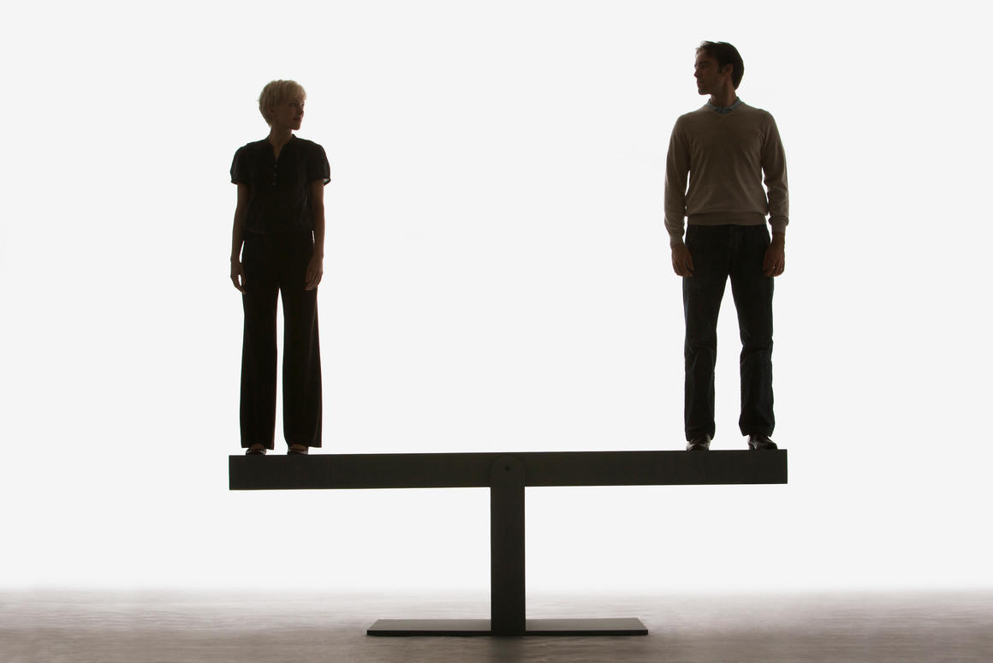
Gender Equality-stereotypes-COMMENTS
KEY MANAGMENT PERSONNEL POSITIONS ARE HELD MOSTLY BY MEN
It’s partly true. The reasons of that are:
-men stay in the work force longer (they are older when they retire)
-women are absent from work due to materinity leaves,

Slide 15
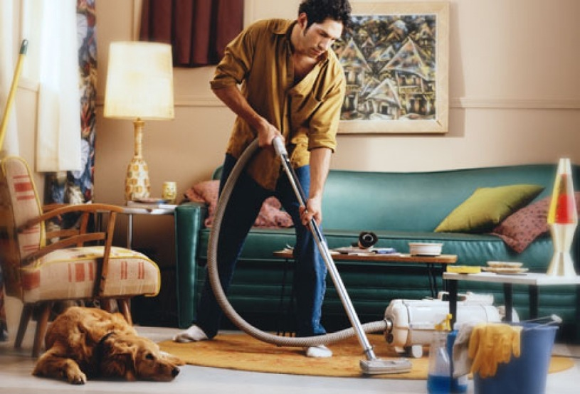
Gender Equality-stereotypes-COMMENTS
WOMEN HOLD TWO FULL TIME JOBS AT THE SAME TIME- AT PAID POSITION AND AT HOME
Partly true. It happens very often. But it’s quite common that man and woman take turns in household duties and fathers take care of their kids.

Slide 16
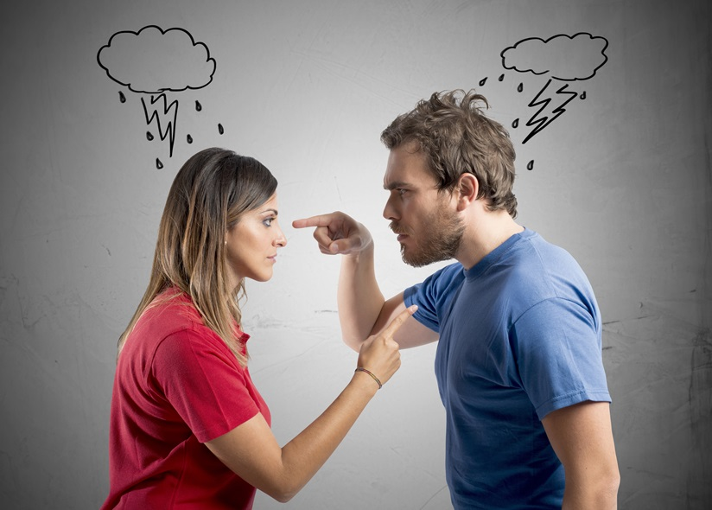
Gender Equality-stereotypes-COMMENTS
WOMEN ARE OFTEN TARGET OF DOMESTIC VIOLENCE
Not true. Research which was carried out in 2012 showed that:
- 11 % of women told they were victims of domestic violence
- 10 % of men told they were victims of domestic violence

Slide 17
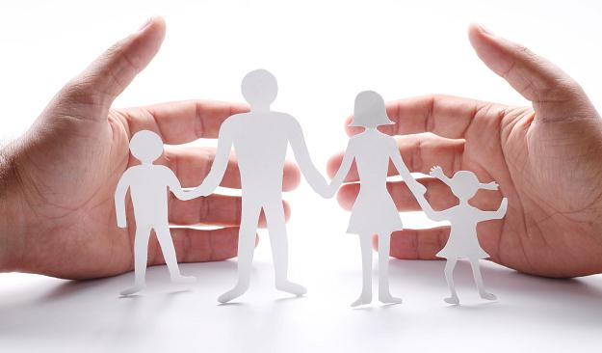
Gender Equality-stereotypes-COMMENTS
WOMEN ARE VICTIMS OF POOR PRO-FAMILY POLICY
Partly true. In 2016 in Poland pro-family policy was introduced. It means each family gets the money for every kid (500+) – it means more kids=more money.

