Slide 1
Erasmus+ Time Machine
Great and infamous moments in history

Slide 2
Infamous moments

Slide 3
The Black Death
The disastrous mortal disease known as the Black Death spread across Europe in the years 1346-53. The frightening name, however, only came several centuries after its visitation (and was probably a mistranslation of the Latin word ‘atra’ meaning both ‘terrible’ and ‘black)’.
The tragedy was extraordinary. In the course of just a few months, 60 percent of Florence’s population died from the plague, and probably the same proportion in Siena.

Slide 4
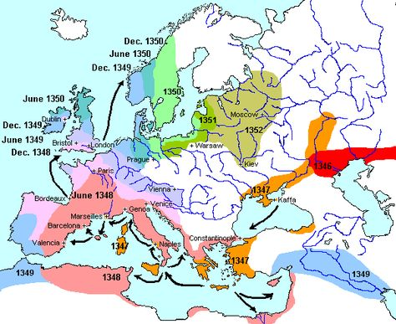
Spread of the Black Death

Slide 5
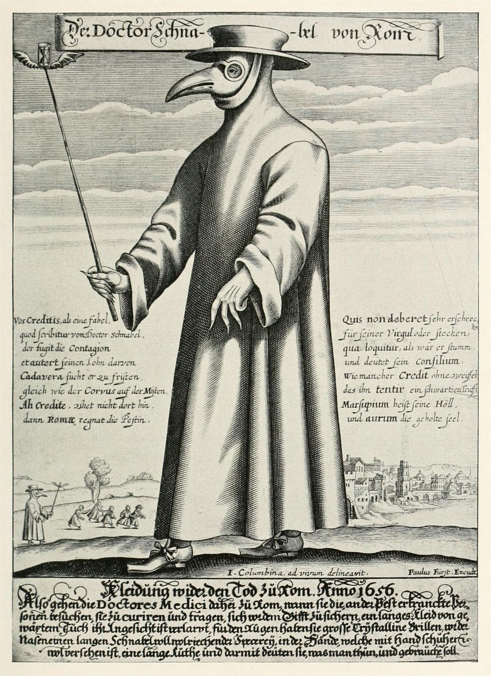
Plague Doctor
A plague doctor was a medical physician who treated victims of the Black Death. Community plague doctors were quite valuable and were given special privileges; for example, plague doctors were freely allowed to perform autopsies, which were otherwise generally forbidden in Medieval Europe, to research a cure for the plague.

Slide 6
First World War
World War I, also known as the Great War, the Seminal Catastrophe, and initially in North America as the European War, was a global war originating in Europe that lasted from 28 July 1914 to 11 November 1918. Contemporaneously described as "the war to end all wars", it led to the mobilisation of more than 70 million military personnel, including 60 million Europeans, making it one of the largest wars in history. It is also one of the deadliest conflicts in history, with an estimated nine million combatants and seven million civilian deaths as a direct result of the war, while resulting genocides and the resulting 1918 influenza pandemic caused another 50 to 100 million deaths worldwide.
On 28 June 1914, Gavrilo Princip, a Bosnian Serb Yugoslav nationalist, assassinated the Austro-Hungarian heir Archduke Franz Ferdinand in Sarajevo, leading to the July Crisis. In response, on 23 July Austria-Hungary issued an ultimatum to Serbia. Serbia's reply failed to satisfy the Austrians, and the two moved to a war footing.

Slide 7
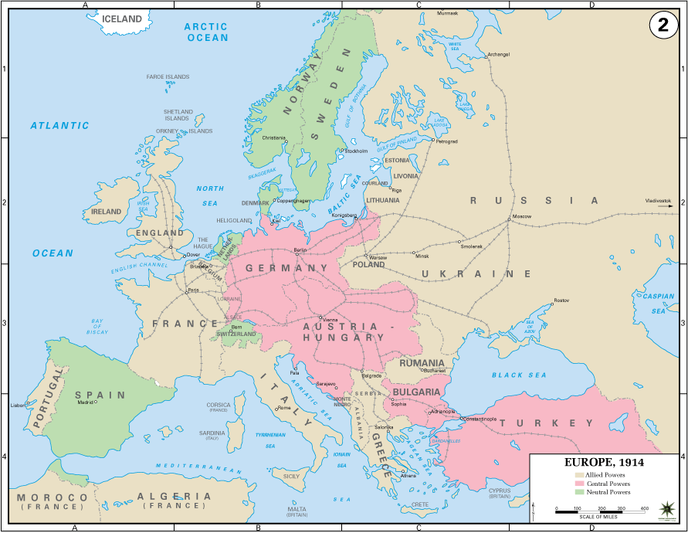

Slide 8
World War II
The largest world war in history, lasting from September 1, 1939 to September 2, 1945.
It covered almost all of Europe, eastern and south-eastern Asia, northern Africa, part of the Middle East and all oceans.
In total, war losses and damage are not determinable. Even more than 80 million people were killed. The war brought enormous and irreparable damage in Poland. The number of fatalities is estimated at 6 to 7.5 million.

Slide 9
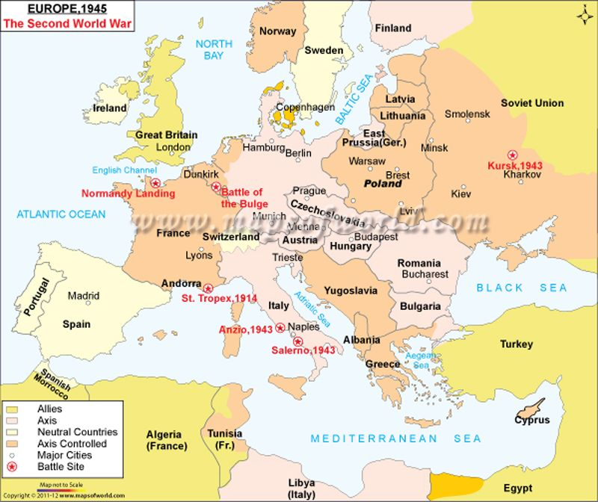
The second world war

Slide 10
Auschwitz-Birkenau
Symbol of the Holocaust, also known as the "death factory". The only concentration camp on the UNESCO World Heritage List.
Used after Germany's aggression on Poland in 1939 and the annexation of these lands by the Third Reich.
In 1940, in these areas, the German authorities set up a camp initially intended to settle political prisoners and opposition, mainly Poles.
No one knows exactly how many people were sent to Auschwitz, or how many died there. However, historians estimate that between 1940 and 1945, the Nazis sent at least 1.3 million people to Auschwitz. About 1.1 million of these people died or were killed at Auschwitz.

Slide 11
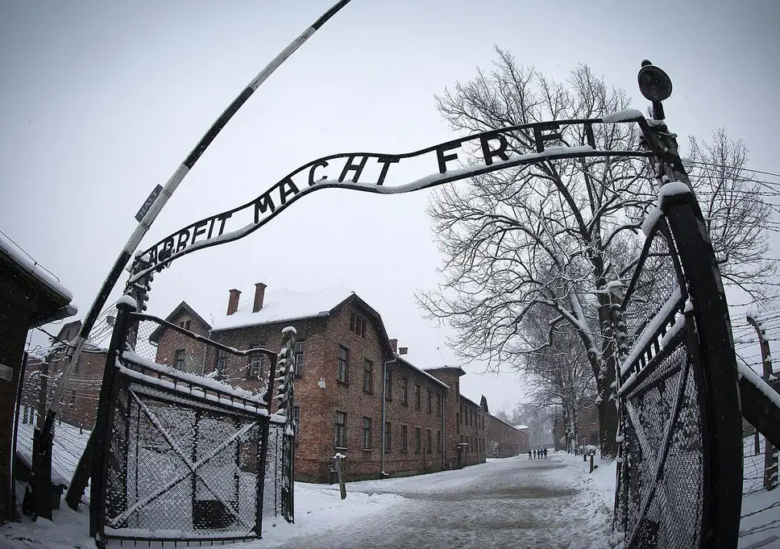
Main gate in Auschwitz

Slide 12
Developement
of Nuclear Weapons
Nuclear weapons possess enormous destructive power from nuclear fission or combined fission and fusion reactions. Building on scientific breakthroughs made during the 1930s, the United States, the United Kingdom and Canada collaborated during World War II, in what was called the Manhattan Project, to counter the suspected Nazi German atomic bomb project. In August 1945, two fission bombs were dropped on Japan, standing to date as the only use of nuclear weapons in combat. The Soviet Union started development shortly thereafter with their own atomic bomb project, and not long after that both countries developed even more powerful fusion weapons known as "hydrogen bombs". The notion of using a fission weapon to ignite a process of nuclear fusion can be dated back to 1942. At the first major theoretical conference on the development of an atomic bomb hosted by J. Robert Oppenheimer at the University of California, Berkeley, participant Edward Teller directed the majority of the discussion towards Enrico Fermi's idea of a "Super" bomb that would use the same reactions that powered the Sun itself.

Slide 13
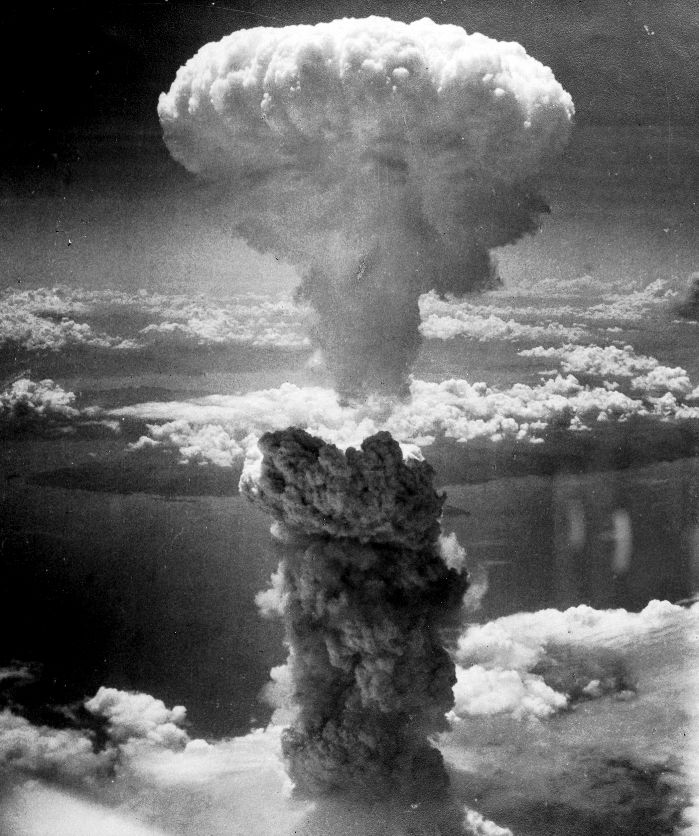
The mushroom cloud of the atomic bombing of the Japanese city of Nagasaki on August 9, 1945, rose some 11 mi (18 km) above the bomb's hypocenter.

Slide 14
Terrorism
Over the past decade, terrorists killed an average of 21,000 people worldwide each year.
The global death toll from terrorism over the past decade ranged from 8,000 in 2010 to a high of 44,000 in 2014.
In 2017, terrorism was responsible for 0.05% of global deaths.
Terrorism tends to be very geographically-focused: 95% of deaths in 2017 occurred in the Middle East, Africa or South Asia.
In most countries terrorism accounts for less than 0.01% of deaths, but in countries of high-conflict, this can be as much as several percent.
Airline hijackings were once common but are very rare today.
Public concern about terrorism is high – in many countries more than half say they are concerned about being a victim.

Slide 15
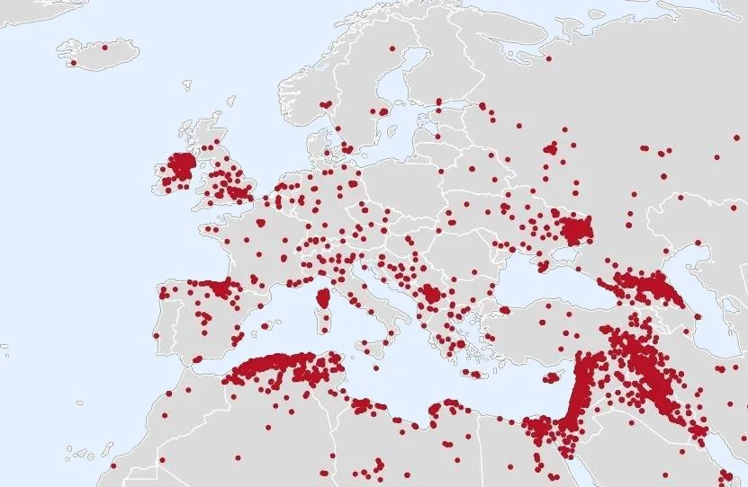
Terrorism in Europe

Slide 16
Great moments

Slide 17
The Life of Jesus of Nazareth
The life of Jesus of Nazareth did dramatically impact history. If you follow the dating system that we use today, you acknowledge his impact. This article is published in 2010 A.D. because approximately 2010 years ago, Jesus lived in Israel. At the time of his life, it might not have seen so dramatic to the world at large. He never traveled more than a few days' journey from his hometown. It was only after he left earth that his teachings spread beyond his homeland and began to cause trouble for the ruling power of the time: Rome. When Roman rulers began to persecute the followers of Jesus, Christians, his life really began to ripple out around the globe. Over time, Christianity was accepted by the Roman rulers, which allowed it to spread even further. Today, Christianity is one of the largest religions of the world.

Slide 18
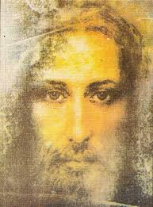
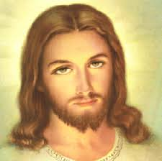
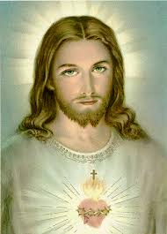
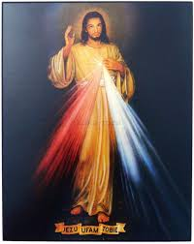
Portraits of Jesus Christ

Slide 19
The Reformation
The Reformation (1517-1648) was one of the greatest events in European history. Prior to this period, the Roman Catholic Church had close to absolute control over the people and governments of the Christian world. It was when many of the learned men of the time began to question the practices of the church in comparison to the Bible that trouble arose. The intent of the Reformation was to reform the Catholic Church and bring it back to its biblical roots. The end result was a rending of the church into two factions: Catholics and Protestants. The Reformation brought the religious texts into the hands of the masses and began the decline of the Catholic power.

Slide 20
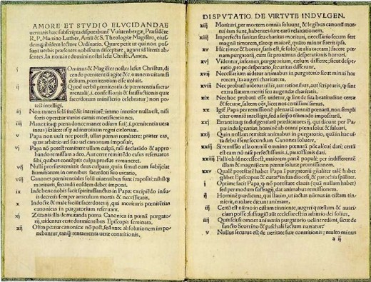
95 Theses by Martin Luther

Slide 21
The Industrial Revolution
The second half of the 18th century saw scientific and technological changes that would radically change the world. The first "industrial revolution" began around the 1760s and ended sometime in the 1840s. During this time, mechanization and factories altered the nature of economics and society. In addition, urbanization and industrialization reshaped both the physical and mental landscape.
This was the age when coal and iron took over industries and began to modernize production systems. It also witnessed the introduction of steam power that revolutionized transportation. This led to a great population shift and growth as the world had never seen.

Slide 22
Fall of the Berlin Wall and th fall of communism
The Berlin Wall, was a guarded concrete barrier that physically and ideologically divided Berlin from 1961 to 1989. Construction of the Wall was commenced by the German Democratic Republic (GDR, East Germany) on 13 August 1961. The Wall cut off West Berlin from surrounding East Germany, including East Berlin.
The fall of the Berlin Wall, on 9 November 1989, was a pivotal event in world history which marked the falling of the Iron Curtain. The fall of the inner German border took place shortly afterwards. An end to the Cold War was declared at the Malta Summit three weeks later, and the reunification of Germany took place during the following year.

Slide 23
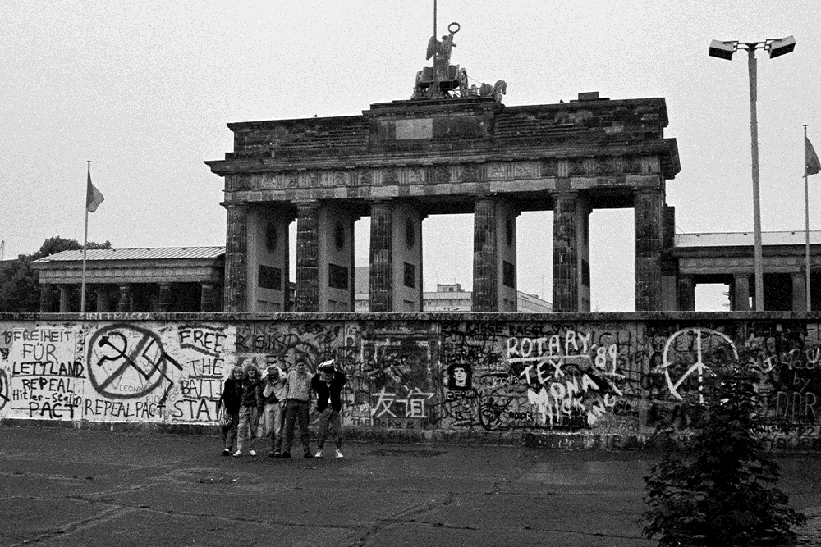
Berlin Wall- Before and after

Slide 24
European Union
The European Union was formally established when the Maastricht Treaty—whose main architects were Helmut Kohl and François Mitterrand—came into force on 1 November 1993. It’s a political and economic union of 28 member states that are located primarily in Europe.[11] Its members have a combined area of 4,475,757 km2 (1,728,099 sq mi) and an estimated total population of about 513 million.

Slide 25
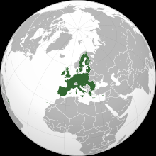
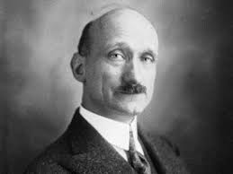
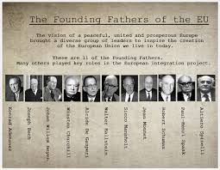
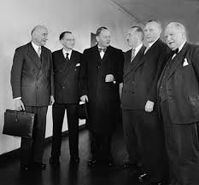

Slide 26
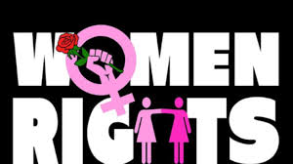
Women’s Human Rights
Women’s rights are the fundamental human rights that were enshrined by the United Nations for every human being on the planet nearly 70 years ago. These rights include the right to live free from violence, slavery, and discrimination; to be educated; to own property; to vote; and to earn a fair and equal wage.
As the now-famous saying goes, “women’s rights are human rights.” That is to say, women are entitled to all of these rights.
Winning rights for women is about more than giving opportunities to any individual woman or girl; it is also about changing how countries and communities work. It involves changing laws and policies, winning hearts and minds, and investing in strong women’s organizations and movements.

